Slide 1
Akshat Kaushik
WebSVF:
Interactive Online Code Analysis to Improve Software Quality, Reliability, and Security
Link to Audio-Video Presentation: https://akshatsinghkaushik.github.io/WebSVF-Presentation

Slide 2

About Me
Akshat Kaushik
I’m finishing my Bachelor’s degree in Software Engineering
github.com/akshatsinghkaushik Passionate about open-source development
About Me

Slide 3





WebSVF
Delete this blue circle and click icon to insert your image. See instructions on Slide 18
Delete this blue circle and click icon to insert your image. See instructions on Slide 18
Project
Interactive Online Code Analysis to Improve Software Quality, Reliability, and Security
Team
Like pieces in a puzzle, every member of the team has a crucial role to play in developing the WebSVF project.
Supervision
The project would not have been possible without the advice and mentoring we received every week working under the supervision of Dr. Yulei Sui

Slide 4
Background
Static Value-Flow Analysis (SVF), an open source tool for programs written in C/C++ provides analyses by scanning the flow of information and data individually as well as their interdependence for increasingly improved precision.
WebSVF had a simple objective in the beginning, to create a user-friendly Graphic User Interface for SVF and its derived applications.

Slide 5

Problem
Its hard to not like open-source code, 90% of the code being written and used today is based on open source projects.
The same reasons that make open source projects so likeable also opens them up to all kinds of vulnerabilities, in turn affecting countless pieces of software that used the original open source project and in turn putting the data of millions of users at risk.
Taking the appropriate measures to constantly update bug analysis tools and proofing software has become a necessity in the industry.

Slide 6
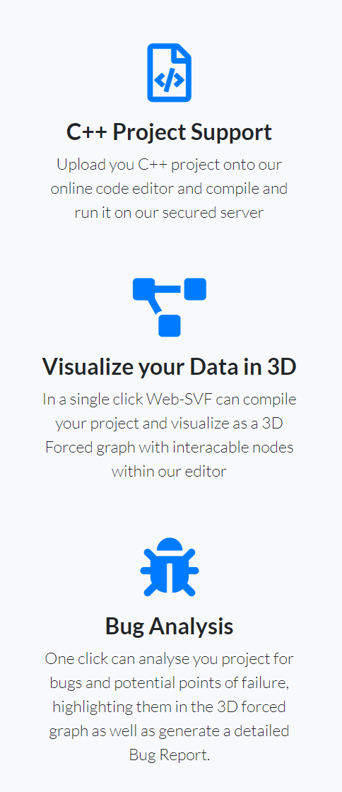
WebSVF
Creates visually appealing web-pages from complex bug reports and bundles 3D visualization tools allowing the user to interact with the project code in an unprecedented manner:
1. Bug Reports: Gone are the days of daunting bug reports full of complex terms, line numbers and detailed information about errors occurring in the project. WebSVF transforms these reports into modern web pages summarizing the key information and abstracting the daunting details.
2. 3D Code Map: Ever wanted to visualize your project data into something that even kids could interact and play with. Don’t worry its not just a game, with key information highlighted in the diagram, users can now visualize projects as 3D diagrams that provide bug information, depict data flow in an interface that you can play with.

Slide 7

Choosing the Interface for our Tools
It was very easy for us to create a Web Interface for our WebSVF analysis tool, since all our tools were built using modern Web design.
Our platform is built primarily for assisting developers, with that in mind we could have either tried to implement the most sought-after features inside our User Interface or integrate our tools with the most widely used development environment, Visual Studio Code (VSCode).
We chose VSCode since it is not only available across all platforms, but also has a robust Extension API (Application Programming Interface) enabling us to add our tools to its interface with minimal changes to our existing code.

Slide 8
Demo – Code Map
Link to Audio-Video Presentation: https://akshatsinghkaushik.github.io/WebSVF-Presentation

Slide 9
Demo – Bug Report
Link to Audio-Video Presentation: https://akshatsinghkaushik.github.io/WebSVF-Presentation

Slide 10

Challenges
The project requirements were all over the place at the beginning. The project scope aimed at achieving high level goals before finalizing the dependent lower level tasks creating a lot of confusion making it difficult to collaborate effectively.
The global pandemic forcing the team to communicate online and often across time zones, made it increasingly difficult to brainstorm, debug and develop our tasks cohesively.

Slide 11
Breakthrough
Sceptical at first, my faith was re-instated after discovering the real potential our application had to offer.
Achieving the goals the goals that seemed too difficult to implement, only half way through the development process, was our greatest breakthrough moment. But personally, our team being able to collaborate effectively in these challenging times to reach our target before time is the real achievement in my books.
“Small daily improvements over time lead to stunning results.” -Robin Sharma

Slide 12
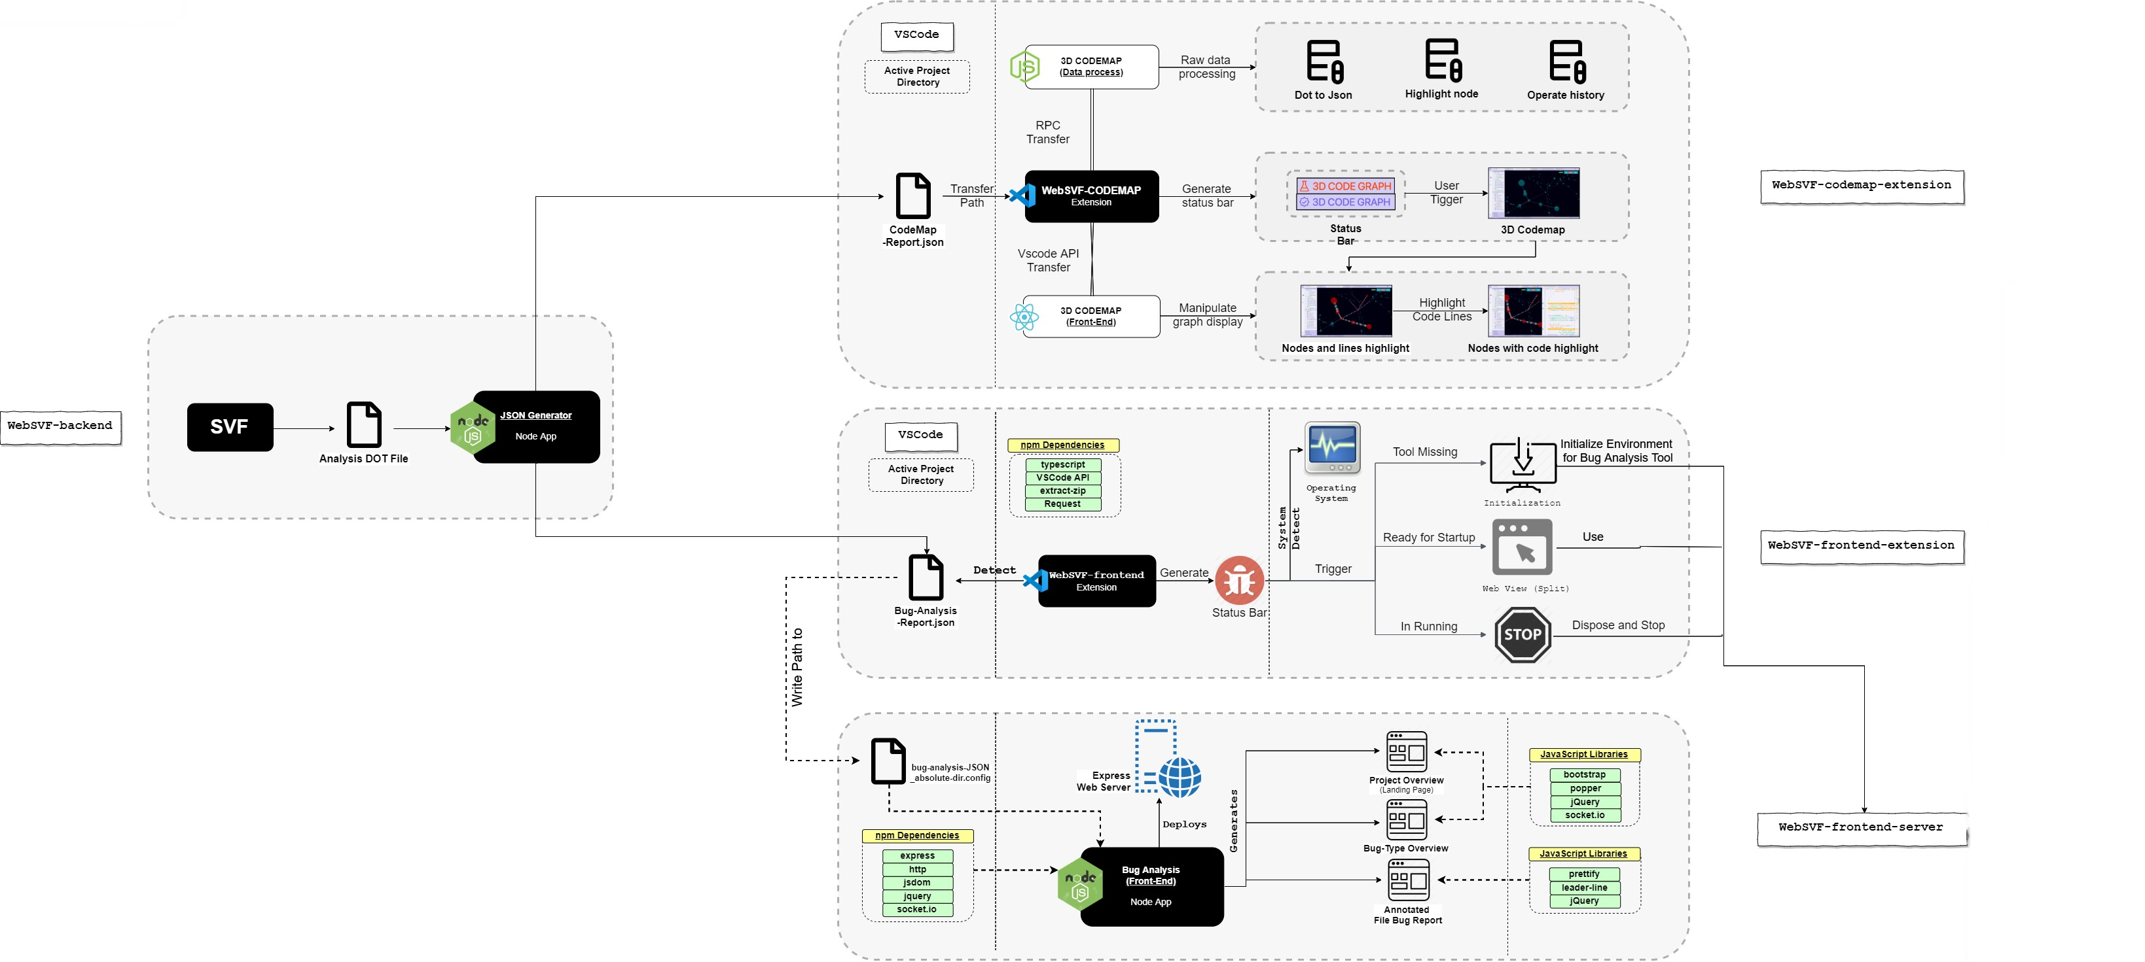
Innovation
Converting command-line based bug analysis information into a modern Web-based Bug Report presentation.
Integrating 3D Code Map representation as an easy to use developer Plugin.

Slide 13
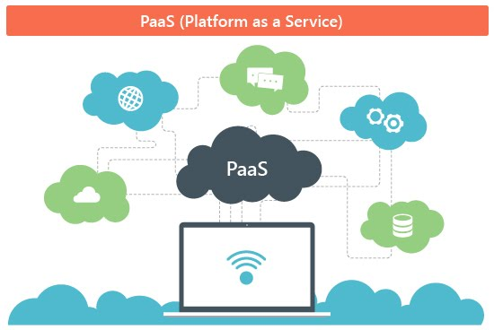
Commercialisation
Modify the current application architecture transforming it from a plug and play tool into a Platform as a Service offering. Where are tools can be offered to users and developers more easily through any Web browser.
The proposed platform will offer a limited free-tier which is limited only because hosting restricted code spaces will still incur costs. While our platform’s team and enterprise tiers would enable more advanced features and the subscription would cover the automation of hosting, deploying, and modifying their code spaces at a much larger scale.

Slide 14
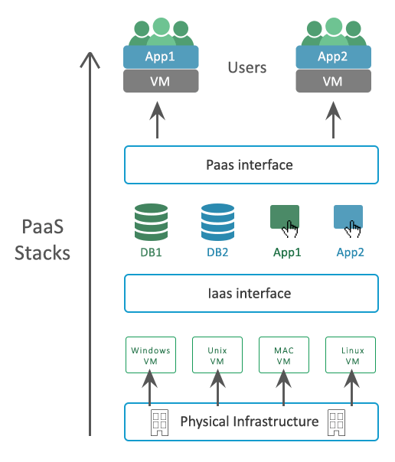
Invention
Our Platform-as-a-service approach to serve users with not just the analysis tools but also the entire code space, including a terminal, code editor and huge marketplace of extensions to add to their code space provides users with a simple solution for many issues that irk developers.
Advanced features in the platform will allow users to configure a code space with the necessary tools and software required for development before they even load the code space for the first time. These configurations can then be used to create multiple instances of an identical code space for entire development team to start working on a project straight away.

Slide 15
Moving Forward…
We believe the future of software development necessitates the implementation of an easy to use bug analysis platform to stop the rapid spread of unchecked vulnerable software since the default analysis tools just don’t cut it these days.
The scope of the WebSVF platform is vast and even if our team is comfortable working on the project in their spare time after this semester, there are multiple other costs that we shall start incurring as we start hosting our software online. Thus we are seeking seed funding to support our research project.
We have applied to have WebSVF as a UTS Startup and we are looking to participate in the On Accelerate and UTS Techcelerator programs.

Slide 16
Thank You for Listening
Any Questions?

